Slide 1


EECS 495 : Advanced Low Power Digital and Mixed Signal Circuit Design
Switch Capacitor DC – DC Voltage Converter
- Karan Shah

Slide 2
Outline
EECS 495: DC –DC Converter
Motivation and Introduction
Review of Existing Work
Design and Challenges
Schematic and Layout
Results
Conclusion

Slide 3
Motivation
EECS 495: DC –DC Converter
Greater demand for more power, greater storage
Compact form – factor demands
Extreme sensitivity to cost and energy
Conventional Inductor based switched converter suffers from limitations
Notes:
-> as the technology is increasing there is a 1
--> Inductor based converter suffer from power and size.

Slide 4
Introduction
EECS 495: DC –DC Converter
Basic Idea:
Obtaining output depending on the switching pattern of switches and configuration
Various Topologies

Slide 5
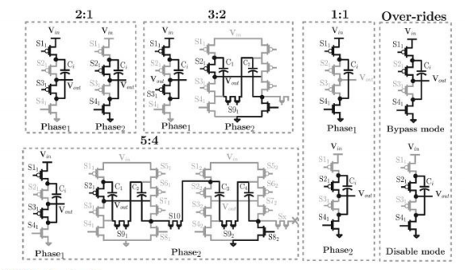
EECS 495: DC –DC Converter
Multiple Transformations Ratios

Slide 6
EECS 495: DC –DC Converter
Review of Existing Work
Literature Referred
(Base for Project): Fully-Integrated Distributed Switched Capacitor DC-DC Converter With High Density MIM Capacitor in 22 nm Tri-Gate CMOS. IEEE JOURNAL OF SOLID-STATE CIRCUITS, VOL. 49, NO. 4, APRIL 2014
Fully Integrated Reconfigurable Switched-Capacitor DC-DC Converter Delivering 0.55W/mm2 at 81% Efficiency. ISSCC 2010 / February 9, 2010
A Sub-ns Response Fully Integrated Battery-Connected Switched-Capacitor Voltage Regulator Delivering 0.19W/mm2 at 73% Efficiency. ISSCC 2013 / February 20, 2013
3.7μW 0.8V VCO-Integrator-Based High-Efficiency Capacitor-Free Low-Dropout Voltage Regulator.
On-Chip Hybrid Regulator Topology for Portable SoCs with Near-Threshold Operation.
5
Notes:
Base achieves around70-80% efficeincy

Slide 7
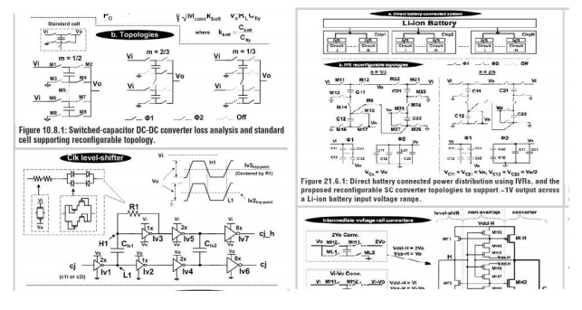
EECS 495: DC –DC Converter
Different Topologies from different papers

Slide 8
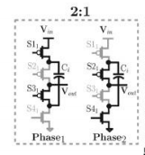
Design
EECS 495: DC –DC Converter
Notes:
2:1 DC – DC voltage Converter
Input Voltage: 1.2V
No of Switches: 3 NMOS and 1 PMOS
Two phases as Vpulse and Vth provided

Slide 9
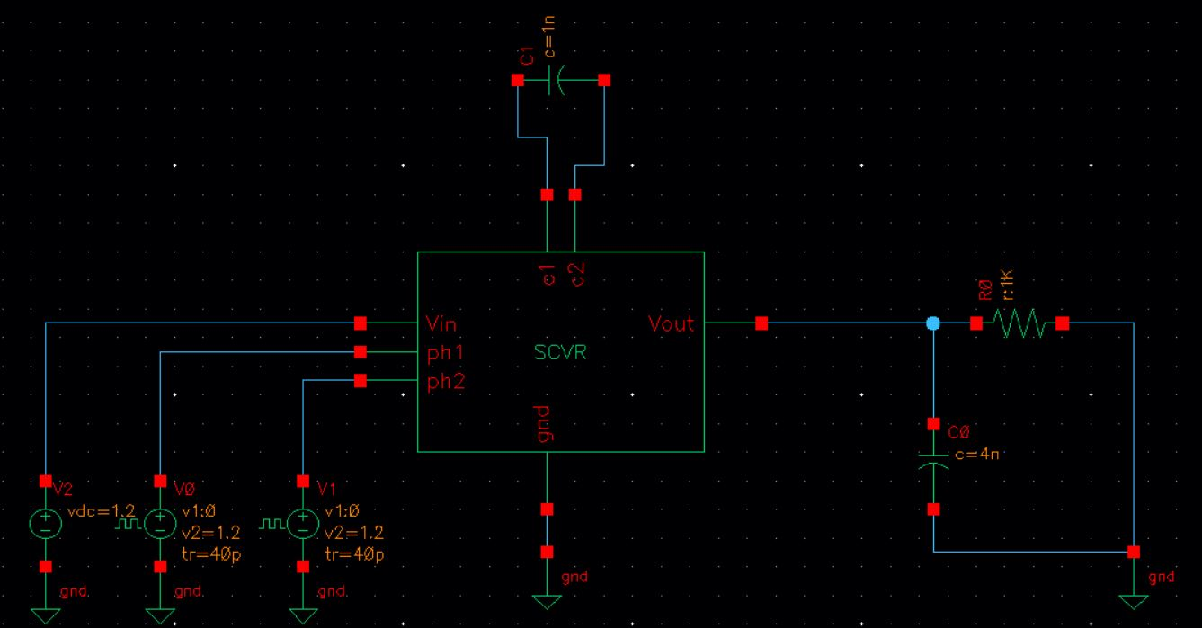
Circuit
EECS 495: DC –DC Converter
Notes:
During phase 1, capacitor is charged
During phase 2, output is given
Ideal output is 0.6V achieved near 1-1.1KΩ

Slide 10
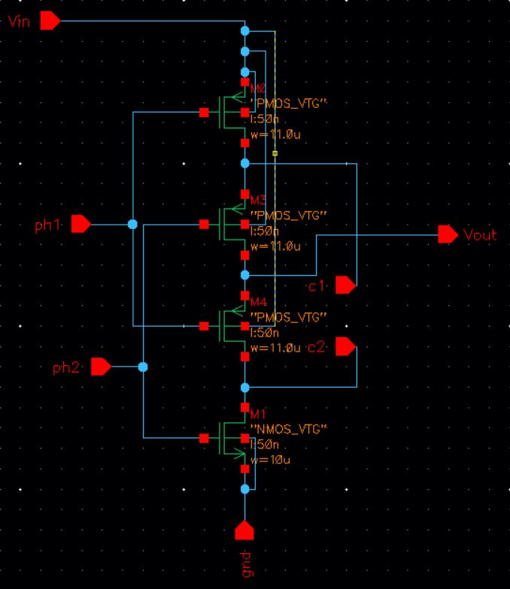
Circuit
EECS 495: DC –DC Converter
Notes:
Regulator Circuit

Slide 11
Challenges
EECS 495: DC –DC Converter
Deciding which circuit to be implemented
Issues with using Cadence
Simulation
Layout design

Slide 12
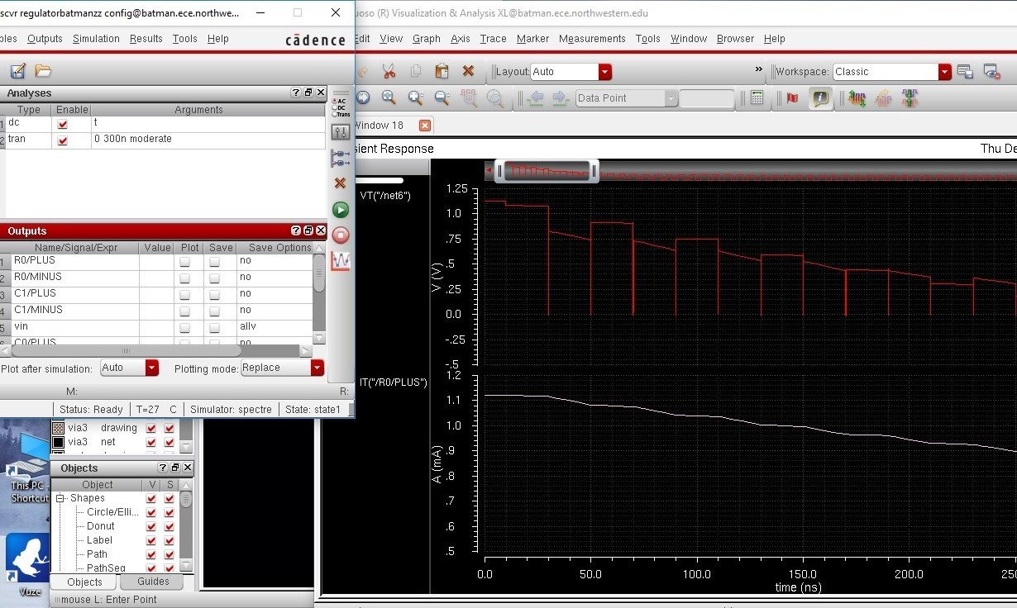
Results
EECS 495: DC –DC Converter

Slide 13
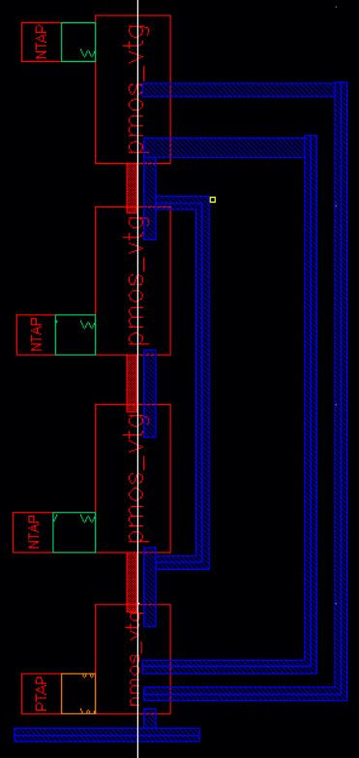
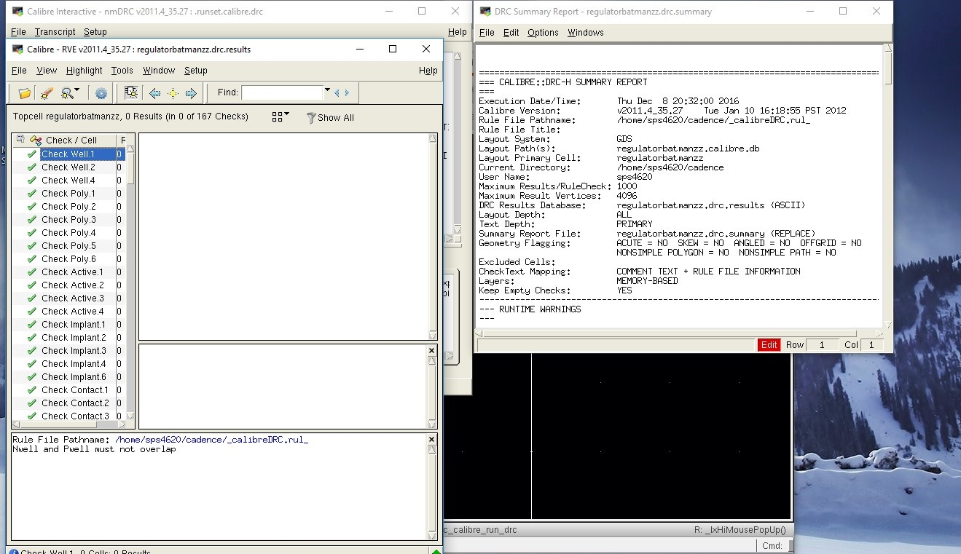
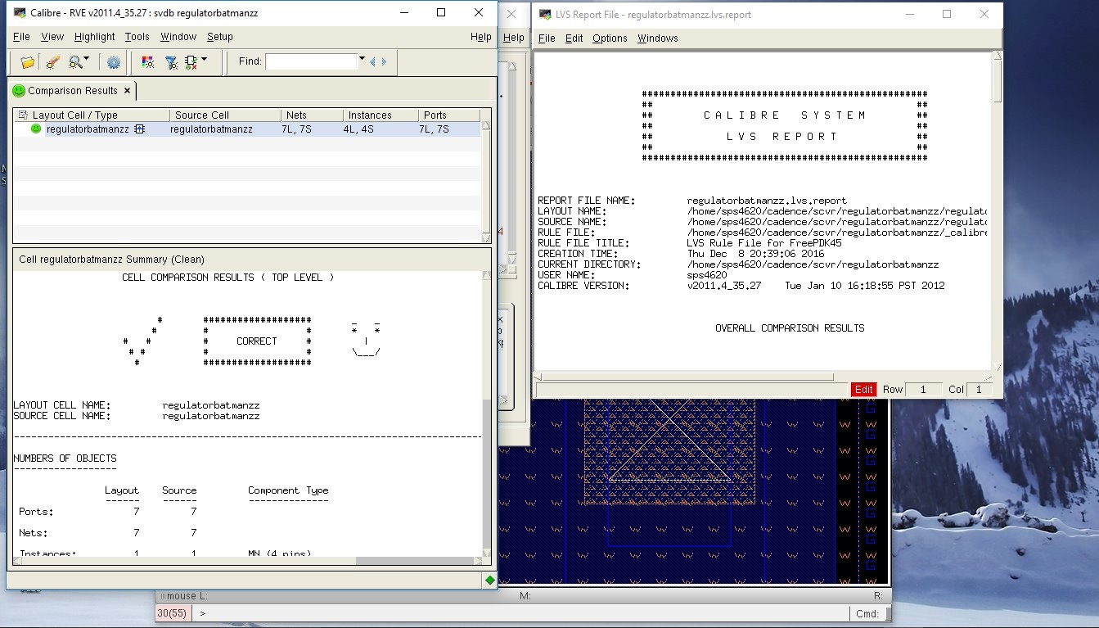
EECS 495: DC –DC Converter

Slide 14
Conclusion
EECS 495: DC –DC Converter
Output is around 0.47V
Load density 0.85 A/mm
Achieve Ideal output

Slide 15
Thank you
EECS 495: DC –DC Converter

